Slide 1
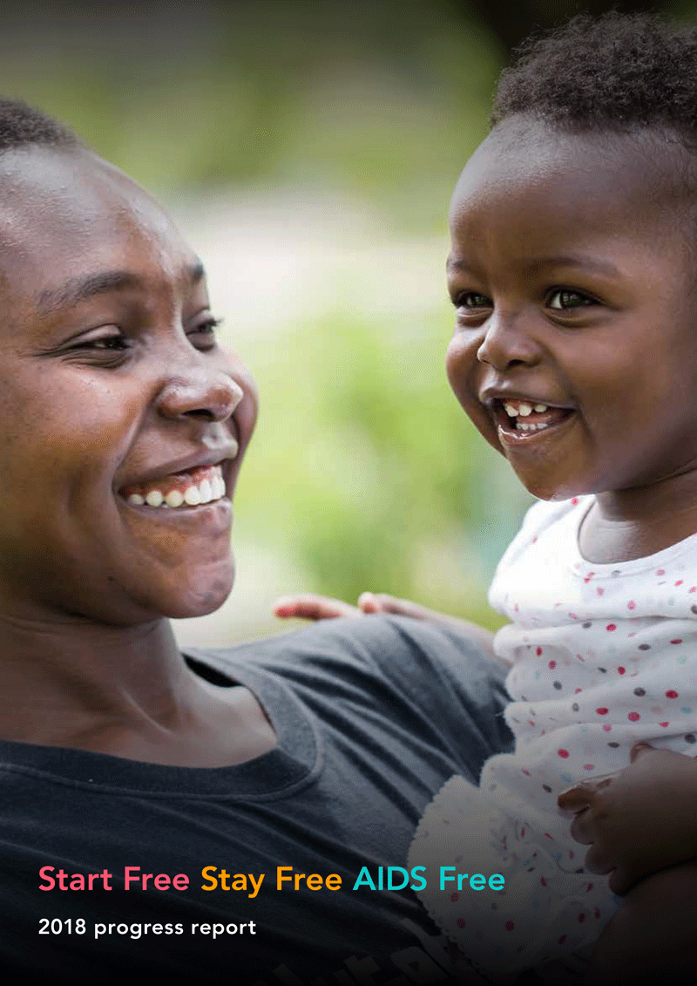



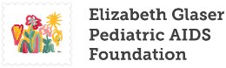
2019 Progress Report launch

Slide 2




Making Prevention Work for Young Women and Girls
The Global Response in 2018
Dr. Chewe Luo MD, PhD, FRCP
Associate Director, Programmes, Chief HIV Section
UNICEF Headquarters, New York
Notes:
The Stay Free focuses on addressing the multiple risks faced by adolescent girls and young women. Given the role age disparate relationships play in driving the risk of HIV acquisition in this population, confirmed by the phylogenic study published by Quarraisha Karim, the mandate includes interventions that target their sexual partners such as medical male circumcision

Slide 3
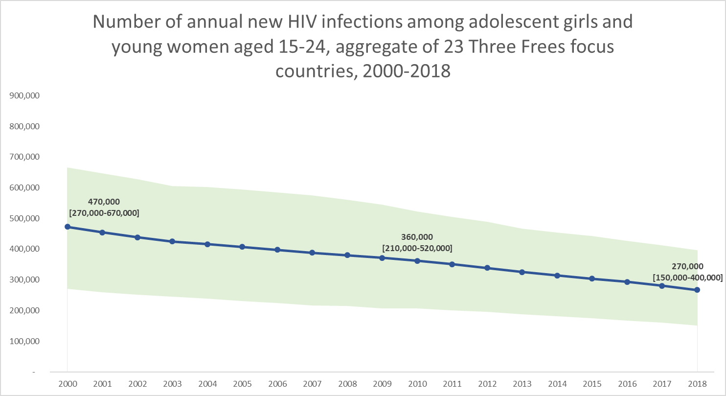
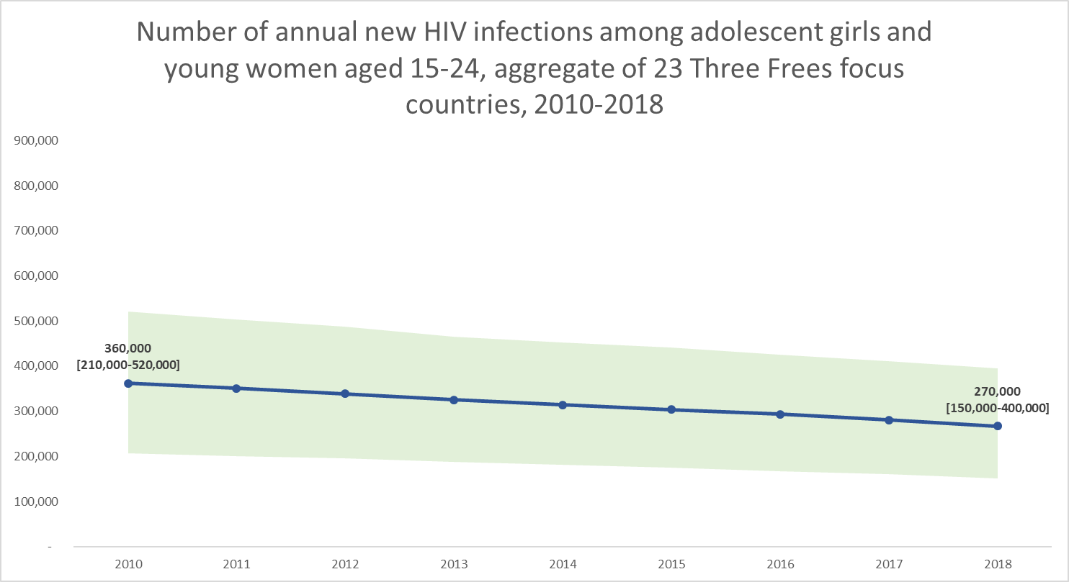
THE STATE OF THE EPIDEMIC RESPONSE
Faltering progress of HIV prevention in young women and girls
Since 2000:
44% reduction
Since 2010:
26% reduction
270470
270270
360
270270
Note: The 23 focus countries are identified in the Three Frees framework and include Angola, Botswana, Burundi, Cameroon, Chad, Côte d’Ivoire, Democratic Republic of the Congo, Eswatini, Ethiopia, Ghana, India, Indonesia, Kenya, Lesotho, Malawi, Mozambique, Namibia, Nigeria, South Africa, Uganda, United Republic of Tanzania, Zambia and Zimbabwe.
Data source: UNICEF analysis of UNAIDS 2019 estimates
Notes:
The pace of reduction of new HIV infections has been slow, although better in adolescent girls and young women. Between 2010 and 2018, there was a 44% reduction. The annual rate of decline has also increased slightly since 2010, now at 3% per year. We know what do to improve the rate of decline.

Slide 4
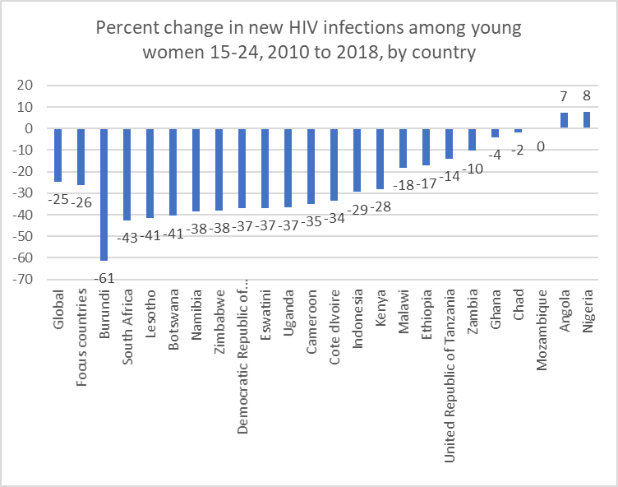
THERE ARE GILMMERS OF HOPE
While off-target, 13 high-burden countries have made appreciable gains (range 28% -61%)
Percent change in new HIV infections among young women and girls 15 -24 (2010 -2018) by country
Data source: Start Free Stay Free AIDS Free 2019 Report
Notes:
In 13 countries, the percentage reduction is more than the 26% average and 4 countries the reduction is more than 40%. In Angola and Nigeria, new infections are increasing.

Slide 5
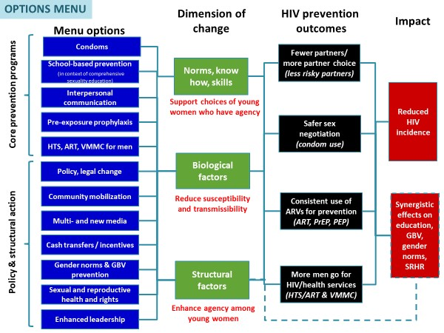
THERE IS GLOBAL CONSENSUS ON THE COMBINATION OF INTERVENTIONS
Defined Menu of Options
Advances a combination of structural, biomedical, and behavioral interventions
Promotes context-specific programming that responds to the unique dynamics of local epidemics
Source: UNAIDS 2018

Slide 6
KEY INITIATIVES ARE IMPLEMENTING THESE MULTIPLE INTERVENTIONS
PEPFAR has invested over $850 million in HIV prevention among adolescent girls and young women through the DREAMS Partnership
PEPFAR Strategy for Prevention in Adolescent Girls and Young Women
Notes:
PEPFAR DREAMS is an bold partnership in 15 countries to help vulnerable girls mature into Determined, Resilient, Empowered, AIDS-Free, Mentored, and Safe women by providing them with a Core Packageh that go beyond the health sector. Interventions include structural drivers that directly or indirectly increase girls’ HIV risk, including poverty, gender inequality, sexual violence, and lack of education.

Slide 7
…AND PRELIMINARY ANALYSES INDICATES PROMISING RESULTS
Average percent declines in DREAMS sub-national units (2015 – 2018 Preliminary Data)
Notes:
In 4 (Kenya, Lesotho, Malawi and Mozambique) of the countries, 100% of districts implementing the DREAMS package had more than a 25% reduction. In 4 (Eswatini, South Africa, Tanzania and Uganda), the 25% reduction was observed in 50-80% of disctricts.
Source: PEPFAR

Slide 8
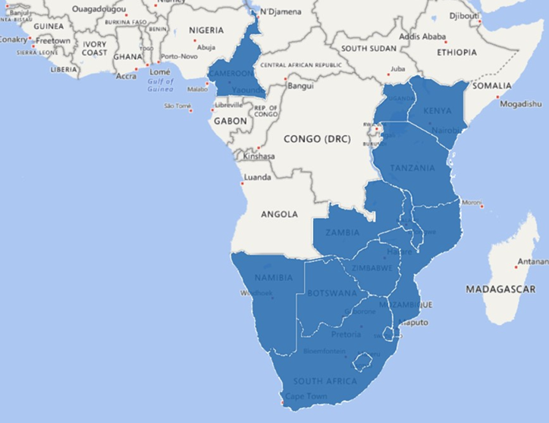
THERE IS AN APPETITE FOR SCALE UP BY NATIONAL PROGRAMMES
Vision
The Global Fund invests in the scale-up of quality and comprehensive programs to contribute to the reduction of HIV incidence amongst girls and women (15-24) in 13 sub-Saharan countries
Contribution Measure(s)
HIV incidence declines for females (15-24) by 58% by 2022 across the 13 countries.
90% of targeted adolescent girls and young women (AGYW) are reached with HIV prevention programs- defined package of services (indicator YP-2) across the 13 countries.
Botswana
Cameroon
Kenya
Lesotho
Malawi
Namibia
Mozambique
South Africa
Swaziland
Tanzania
Uganda
Zambia
Zimbabwe

Slide 9
LEVERAGING THE STAYFREE PARTNERSHIP
Within the Stay Free component, the collaborating agencies have signaled specific commitments to support the translation of lessons learned into scaled up programmes for deeper impact
Key Commitments | Collaborating Agencies
Fostering and enhancing programme coordination | UNAIDS, UNICEF, UNFPA, CIFF, EGPAF, WHO
Knowledge sharing and collaborative learning | UNICEF, GFATM, WHO, PEPFAR, UNAIDS
Promoting SRHR and HIV Linkages | UNFPA, WHO
Availing better data, including key disaggregations and analytics | UNAIDS, UNICEF, WHO, GFATM, PEPFAR, EGPAF
Promoting women and girls’ engagement | UNFPA, GFATM, PEPFAR

Slide 10
DEFINING THE UNFINISHED AGENDA
National authorities are called upon to improve their stewardship of scarce prevention resources through:
  Improved coordination and harmonization of key investments to avoid duplication and for impact and by
  Leveraging of investments in key sectors and
  Investing in better data, to assess coverage and target key gaps
Strengthening the voice, leadership and agency of AGYW in advocacy and design of national prevention programmes is crucial

Slide 11
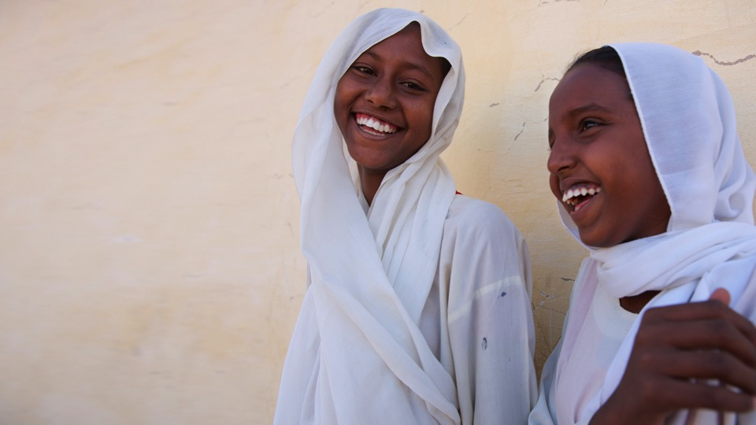
Thank You
Acknowledgements:
Janet Saul (US/GAC)
Damilola Walker (UNICEF)
Chibwe Lwamba (UNICEF)
Aleya Khalifa (UNICEF)
© UNICEF/SUDA2014-XX228/Noorani

Slide 12
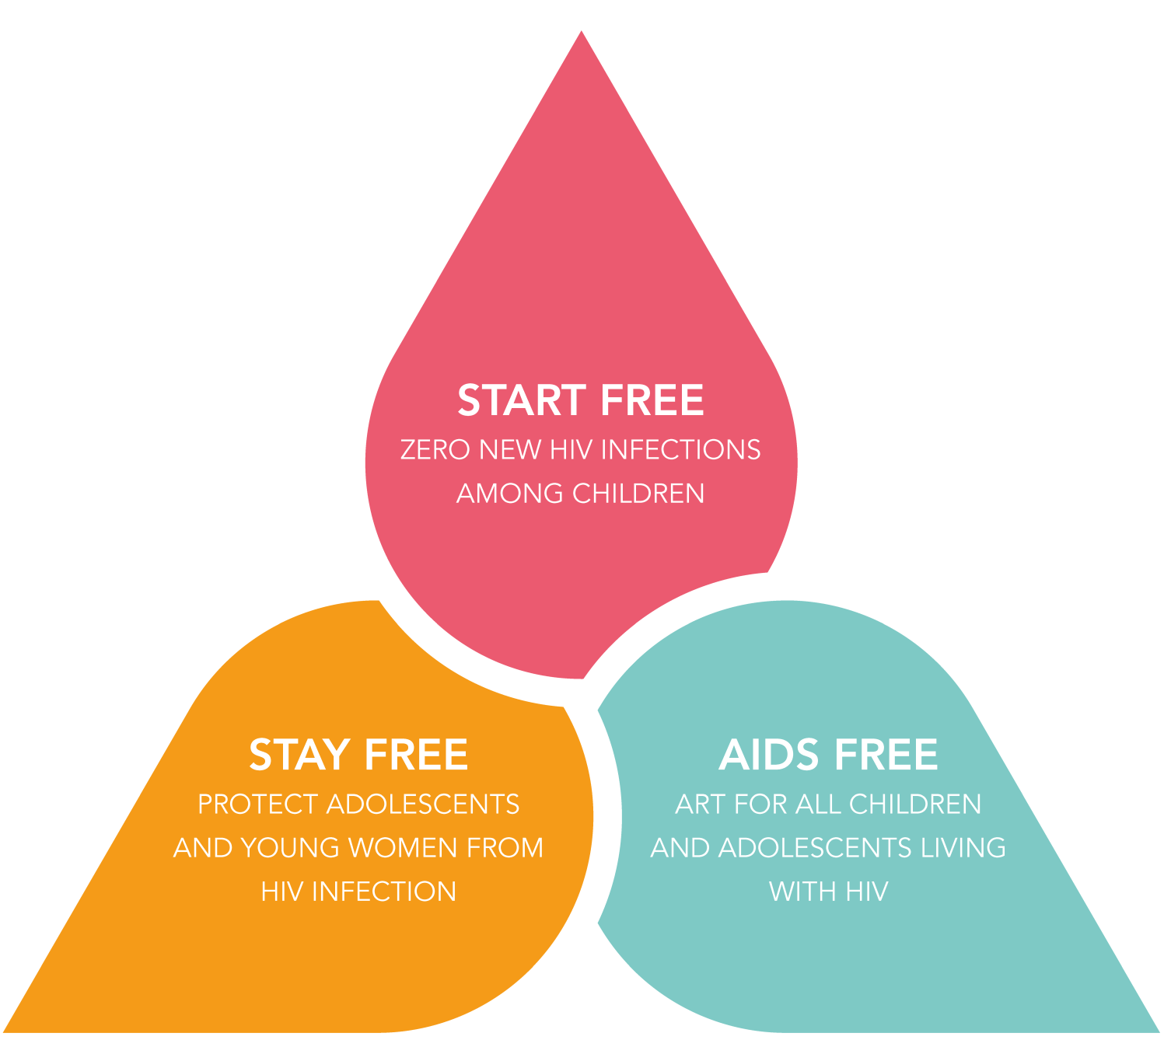
#StartStayAIDSFree

